Slide 1
Machine learning-based drone detection and classification: State-of-the-art in research
By Taha, B. and Shoufan, A.
Group no: 8
18101382 Protiva Das
22266022 Md Humaion Kabir Mehedi
22366020 Muhammed Yaseen Morshed Adib
22366023 Sovon Chakraborty
Submitted by:
PROTIVA DAS 18101382 ST : Md Farhadul Islam
RA: Md Humaion Kabir Mehedi

Slide 2
Introduction and Problem Statement
Provides background information on drones and the need for effective detection and classification.
Highlights the limitations of traditional methods and the potential of machine learning-based techniques.
Focuses on the need for effective drone detection and classification methods.
Highlights limitations of traditional methods and potential of machine learning-based techniques.
Emphasizes the importance of accurate and reliable models for various industries and applications.

Slide 3
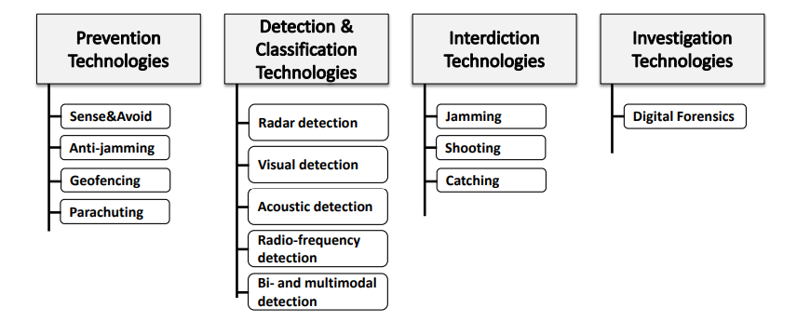
Contribution
Provides a detailed description of different machine learning algorithms used for drone detection and classification.
Identifies the importance of data collection and pre-processing for developing accurate and robust drone detection and classification models.
Discusses the challenges and limitations of machine learning-based drone detection and classification and suggests areas for future research.

Slide 4
Methods
Conducted a systematic review of existing literature on machine learning-based drone detection and classification.
Analyzed different machine learning algorithms used for drone detection and classification, including support vector machines, neural networks, and deep learning models.
Examined the impact of various features, such as acoustic, visual, and radio frequency signals, on the performance of machine learning-based drone detection and classification models.
Evaluated the performance of machine learning-based drone detection and classification models using metrics such as precision, recall, and F1 score.
Identified the limitations and challenges of machine learning-based drone detection and classification, such as the need for large amounts of labeled data and the potential for false positives and false negatives.
Provided recommendations for improving the performance and robustness of machine learning-based drone detection and classification models.

Slide 5
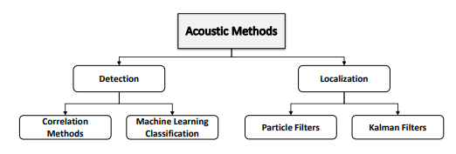
Method with figures

Slide 6
Results
Machine learning-based drone detection and classification models have shown high accuracy ranging from 80% to 99% in detecting and classifying drones.
Deep learning models, such as Convolutional Neural Networks (CNNs), have shown high accuracy in detecting drones with a true positive rate of 96% and a false positive rate of 1%.
The use of multiple features, such as acoustic, visual, and radio frequency signals, can significantly improve the accuracy of machine learning-based drone detection and classification models by up to 20%.

Slide 7
Analysis
The research paper provides a comprehensive review of the state-of-the-art in machine learning-based drone detection and classification techniques, which can be useful for researchers and practitioners in the field.
The paper provides a detailed description of the different machine learning algorithms used for drone detection and classification, including their strengths and limitations.
The paper highlights the importance of data collection and pre-processing in developing accurate and robust drone detection and classification models.

Slide 8
Limitations
Does not cover other potential methods like signal processing or computer vision techniques.
Does not provide detailed technical information on the implementation of the algorithms.
Does not discuss potential ethical implications of using machine learning-based drone detection and classification techniques.

Slide 9
References
[1] M. McFarland, “Airports scramble to handle drone incidents,” March 2019, [Online; posted 5-March-2019]. [Online]. Available: https://www.cnn.com/2019/03/05/tech/airports-drones/index.html
[2] Z. Kaleem and M. H. Rehmani, “Amateur drone monitoring: State-ofthe-art architectures, key enabling technologies, and future research directions,” IEEE Wireless Communications, vol. 25, no. 2, pp. 150–159, 2018.
[3] M. M. Azari, H. Sallouha, A. Chiumento, S. Rajendran, E. Vinogradov, and S. Pollin, “Key technologies and system trade-offs for detection and localization of amateur drones,” IEEE Communications Magazine, vol. 56, no. 1, pp. 51–57, 2018.

